Slide 1

Welcome to the ESO Call!
10am -11am CT
First Wednesday of Each Month

Slide 2
December ESO Call Agenda
I. Welcome
II. New Member Introductions
Please introduce yourself and let us know how we can connect with you.
III. Entrepreneurial Spotlight
Jacob Arnold, Chief Operating Officer, Granted
IV. Community Announcements

Slide 3
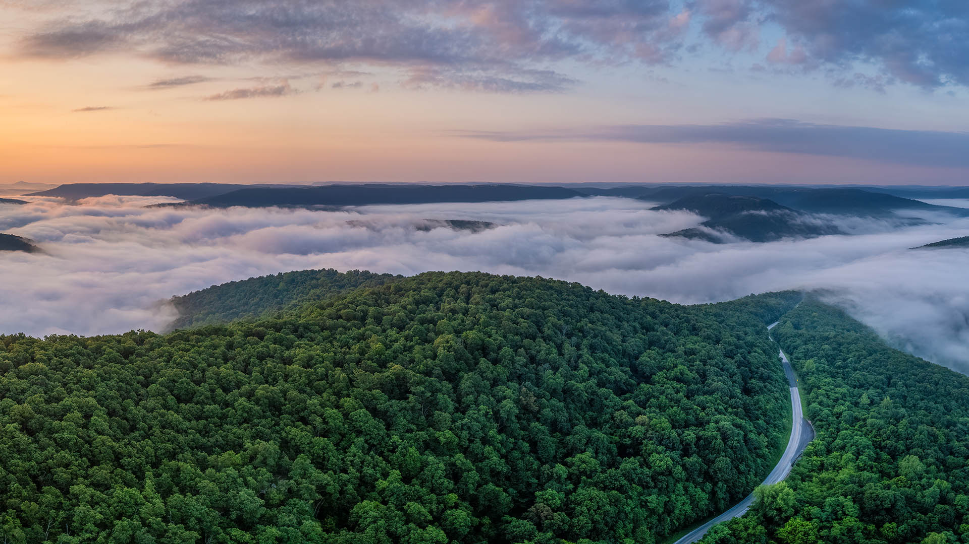




Considerations
We begin promptly at
10am CT on the ﬁrst Wednesday of each month. Calls are limited to one hour.
Meetings are recorded and will be made available upon request.
Please mute your microphones unless speaking.
If you have an announcement, please make sure you send it in our announcement link on our website.

Slide 4

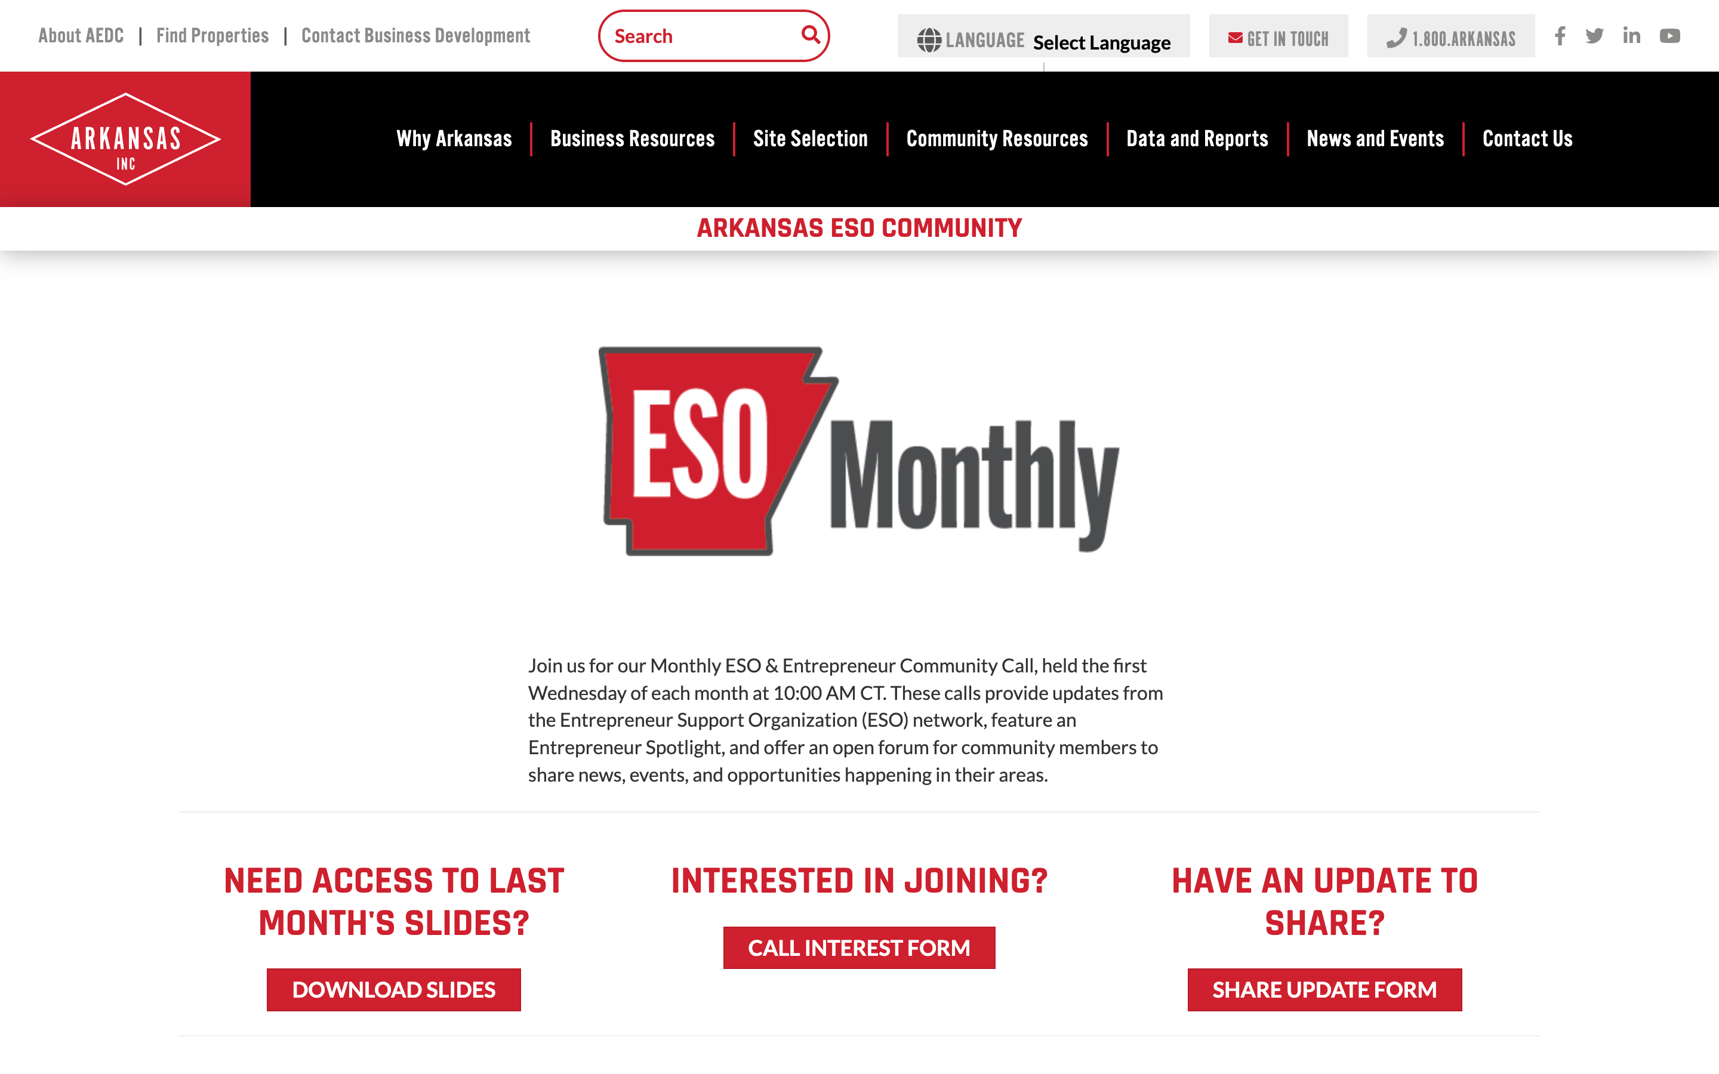
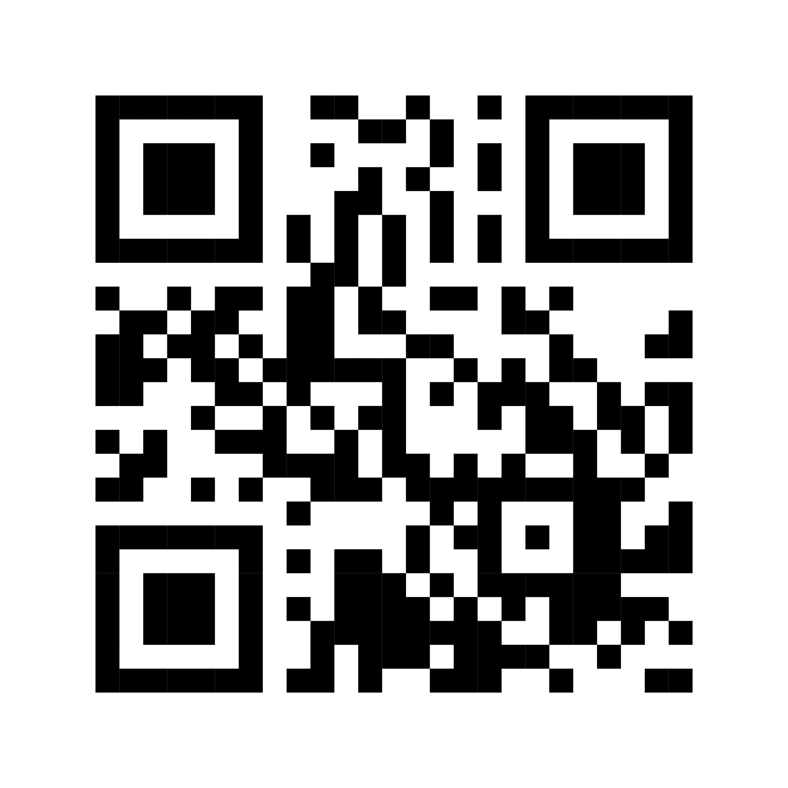
ESO Call Landing Page
A central location where you can find important links such as the call’s joining link, community updates, the previous ESO slide deck, and more.
If you have questions or concerns, please contact:
Mallory Race, Senior Project Manager
Arkansas Economic Development Commission
Mallory.Race@ArkansasEDC.com
bit.ly/AR-ESO

Slide 5
New Member Introductions

Slide 6


F I N D. W I N.
S T RAT EG I C S OLUT I ONS
M A N A G E.
2025

Slide 7
Our Story
In 2011 an EF-5 tornado devastated Joplin, Missouri, the hometown of our founder Shannon Anastosopolos. In the recovery that followed, Shannon joined Deloitte, later PwC, helping administer Joplin’s grant-funded recovery to rebuild essential housing, infrastructure, and public services. That work exposed a persistent gap: communities often have the will and projects, but lack the bandwidth to navigate complex funding. GRANTED was built to close that gap.
Based in Northwest Arkansas, GRANTED is a full-spectrum grant solutions firm and thought partner to cities, counties, nonprofits, and innovators. We pair Big-4 discipline with grassroots execution to move from idea to execution—scouting opportunities, drafting competitive proposals, and managing compliance.
F I N D. W I N.
M A N A G E.
Our team has secured $100M+ in competitive funding and managed $100B+ in federally funded programs.
We turn ideas into outcomes; projects delivered, communities strengthened.

Slide 8

Our Success
$100M+ won
To date, GRANTED has secured $100M+ in competitive awards and administered $100B+ in grant-funded projects. Our portfolio spans state and local governments, nonprofits, education systems, small businesses, and development organizations, with awards from public- and private-sector funders. Our engagements consistently close with significant ROIs, built capacity, compliant records, and a delivered pipeline. The outcome is measurable community and economic impact at scale.
Exemplary wins on high-impact grants across infrastructure, housing, health, workforce, and innovation—driven by fit scoring, tight narratives, and disciplined partner coordination.
$100B+ Managed
Seasoned management of complex programs (CDBG-DR, FEMA PA, ARPA, etc.): procurement, subrecipient oversight, reporting, drawdowns,
monitoring, and closeout—with strong
monitoring results and audit readiness.
100x ROI
Turning small investments into large awards. Our mission is to help our clients achieve a 100× Return on Investment for our services.

Slide 9
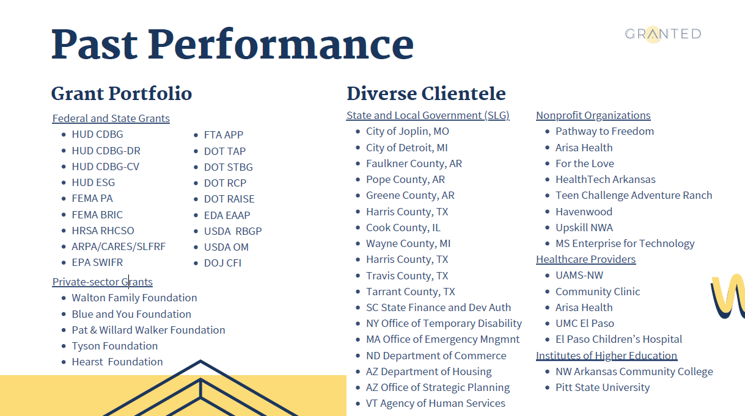
Past Performance
Diverse Clientele
Grant Portfolio
Federal and State Grants HUD CDBG
HUD CDBG-DR HUD CDBG-CV HUD ESG FEMA PA FEMA BRIC HRSA RHCSO
ARPA/CARES/SLFRF EPA SWIFR
Private-sector Grants
Walton Family Foundation Blue and You Foundation
State and Local Government (SLG)
City of Joplin, MO
City of Detroit, MI
Faulkner County, AR
Pope County, AR
Greene County, AR
Harris County, TX
Cook County, IL
Wayne County, MI
Harris County, TX
Travis County, TX
Tarrant County, TX
SC State Finance and Dev Auth
NY Office of Temporary Disability
MA Office of Emergency Mngmnt
ND Department of Commerce
AZ Department of Housing
AZ Office of Strategic Planning
VT Agency of Human Services
Nonprofit Organizations
Pathway to Freedom
Arisa Health
For the Love
HealthTech Arkansas
Teen Challenge Adventure Ranch
Havenwood
Upskill NWA
MS Enterprise for Technology
Healthcare Providers
UAMS-NW
Community Clinic
Arisa Health
UMC El Paso
El Paso Children’s Hospital
Institutes of Higher Education
NW Arkansas Community College
Pitt State University
FTA APP DOT TAP DOT STBG DOT RCP DOT RAISE EDA EAAP USDA RBGP USDA OM DOJ CFI
Pat & Willard Walker Foundation Tyson Foundation
Hearst Foundation

Slide 10

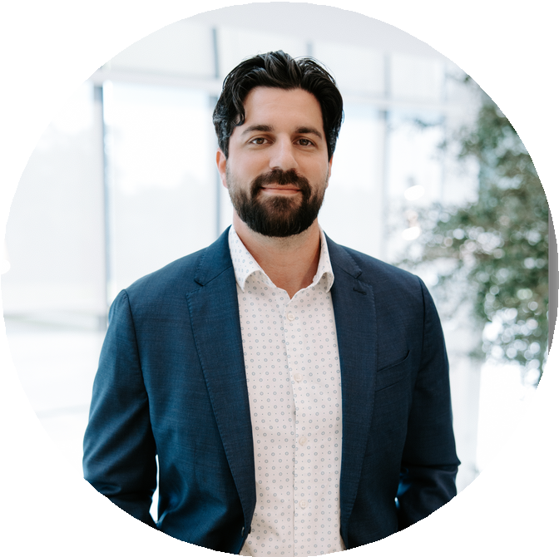
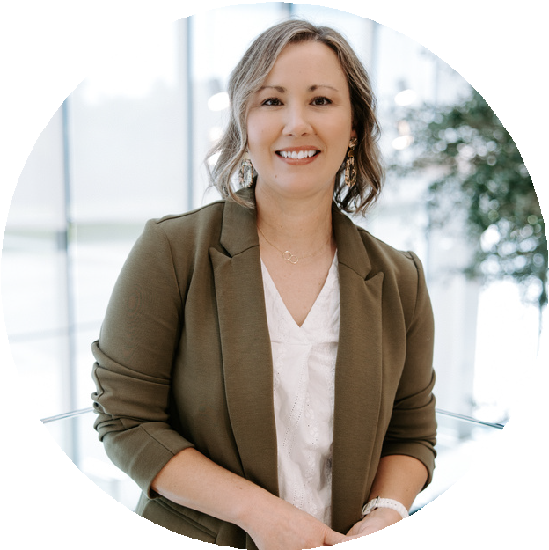
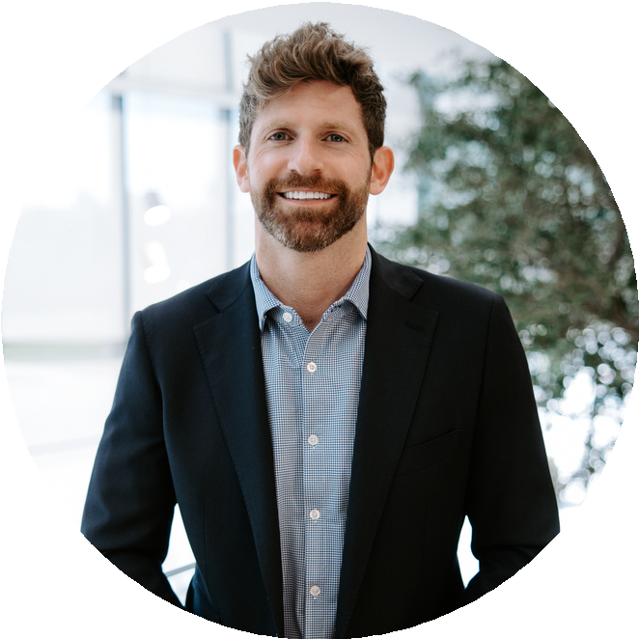
Leadership
Shannon Anastosopolos
FOUNDER, CEO
A strategic leader with deep public and
Deven Daehn
CHIEF IMPACT OFFICER
Rooted in public health and nonprofit leadership, Deven builds high-impact programs and strategic partnerships that drive sustainable organizational and community change.
Jacob Arnold
CHIEF OPERATING OFFICER
A
systemic thinker
specializing in
private sector experience, both
nonprofit strategy, Jacob
development
and grant helps secure
through Big-4 (PwC, Deloitte) and his
passionately organizations
own bootstrapped small business
mission-driven
Shannon leads clients in navigating complex funding landscapes to unlock transformative impact.
meaningful, transformative funding.

Slide 11
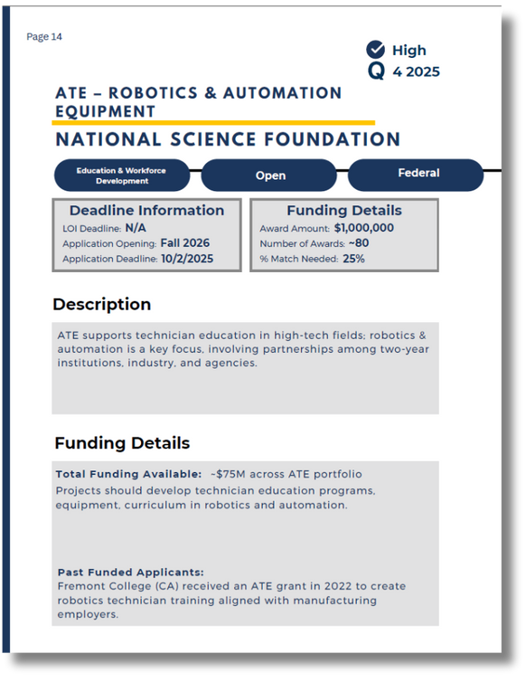
What We Do
Grant Administration
Post-award, we manage compliance end- to-end: kickoff, procurement, subrecipient
oversight, documentation, reporting,
drawdowns, change requests, monitoring, audit readiness, and closeout—so dollars move, risks drop, projects deliver.
Strategic Advisory
We shape funding strategy and capacity:
Grant Research
Our GRANTED Roadmap includes a tailored list of high-impact public- and private- sector grants, mapped to eligible projects and initiatives. We’ll build a forecast and calendar, keeping it updated with real- time monitoring and opportunity alerts.
Grant Writing
Custom quotes matched to opportunity complexity; flat-rate or success-based. We deliver funder-aligned narratives, budgets, workplans, and attachments, coordinating
portfolio design, pipeline governance,
partner mapping, match/in-kind strategy, training, and decision dashboards. So leadership gains clarity, alignment, and predictable execution.
partners and data for a compliant,
*Excerpt from GRANTED Roadmap
competitive submission.

Slide 12


How We Do It
The GRANTED Roadmap
ESSENTIAL PACKAGE
Provides a 3-month forecast of grant opportunities and a 1-hour strategy session to review; all further support is ad-hoc at your discretion.
Grant Identification and Grant Forecast
A focused list of high-priority , active grants. Forecasted grants contingent on selection of Essential or Launch package.
Exploratory Call and Client Profile
Kick-off session to confirm strategic priorities. Intel used to develop bio of client structure and strategy.
LAUNCH PACKAGE

Slide 13


GRANTED
Roadmap cont.
12-Month Roadmap
Strategic Advisory
Grant Writing & Admin
Delivers a comprehensive 12-month forecast of grant opportunities. Our team continuously monitors the funding landscape, updating your roadmap and providing real-time alerts so you never miss a relevant opportunity.
Includes 5 hours of tailored advisory support to align funding pursuits with organizational priorities. Additional strategy sessions can be engaged ad- hoc, giving you expert guidance when and where you need it most.
Provides full-service grant writing and administration on an ad-hoc basis, giving you the flexibility to engage our team only when you need hands-on support with applications or post-award management.

Slide 14
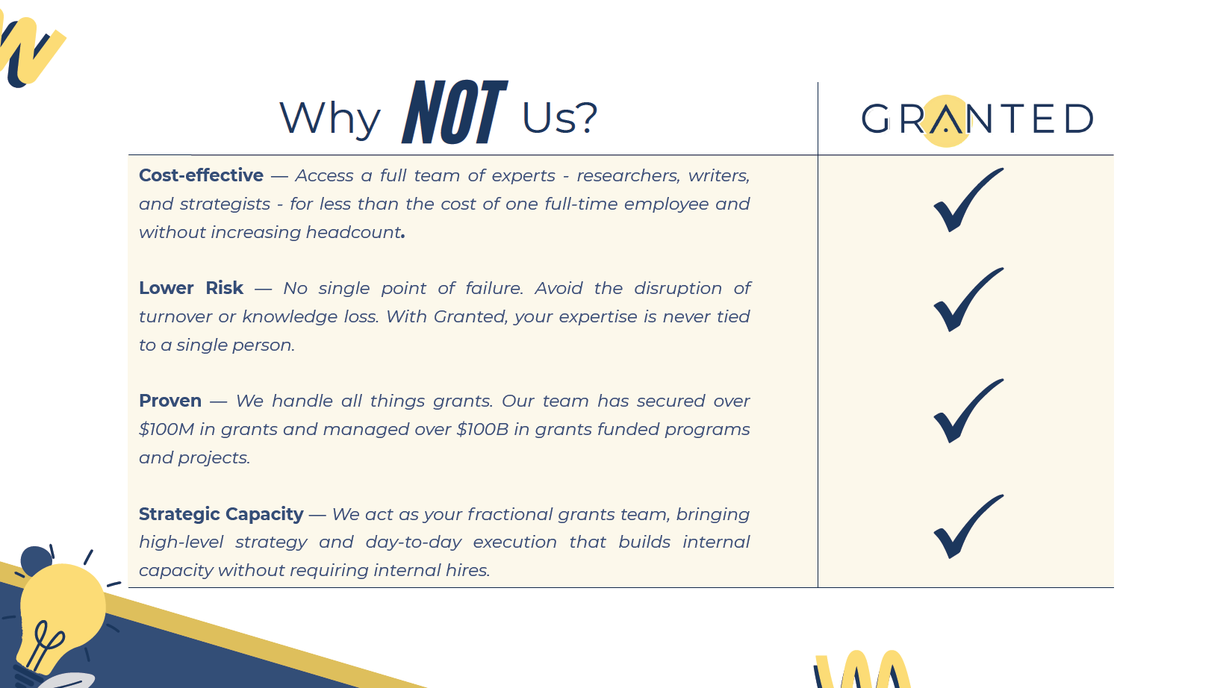

Why NOT Us?
Cost-effective — Access a full team of experts - researchers, writers, and strategists - for less than the cost of one full-time employee and without increasing headcount. Lower Risk — No single point of failure. Avoid the disruption of turnover or knowledge loss. With Granted, your expertise is never tied to a single person. Proven — We handle all things grants. Our team has secured over $100M in grants and managed over $100B in grants funded programs and projects. Strategic Capacity — We act as your fractional grants team, bringing high-level strategy and day-to-day execution that builds internal capacity without requiring internal hires.

Slide 15

Q&A
Ready to pursue funding with
confidence?
Contact Us for More Information
support@grantedco.com www.grantedco.com

Slide 16


December 2025
Community
ANNOUNCEMENTS

Slide 17


Slide 18


Slide 19
Thank you for joining us!
See you next month!
Next meeting will be held January 7th at 10 CT

