Slide 1

Welcome to the ESO Call!
10am -11am CT
First Wednesday of Each Month

Slide 2
July ESO Call Agenda
I. Welcome
II. New Member Introductions
Please introduce yourself and let us know how we can connect with you.
III. Entrepreneurial Spotlight
Heather Nichols CEO & Founder of LyraConnect
IV. Community Announcements

Slide 3

Considerations
We begin promptly at
10am CT on the ﬁrst Wednesday of each month. Calls are limited to one hour.
Meetings are recorded and will be made available upon request.
Please mute your microphones unless speaking.
If you have an announcement, please make sure you email Mallory.Race@arkansasEDC.com

Slide 4


ESO Call Landing Page
A central location where you can find important links such as the call’s joining link, the previous ESO slide deck, and more.
If you have questions or concerns, please contact:
Mallory Race – Senior Project Manager
Arkansas Economic Development Commission
Mallory.Race@ArkansasEDC.com
bit.ly/AR-ESO

Slide 5
New Member Introductions

Slide 6
Entrepreneurial Highlight

Slide 7


Slide 8
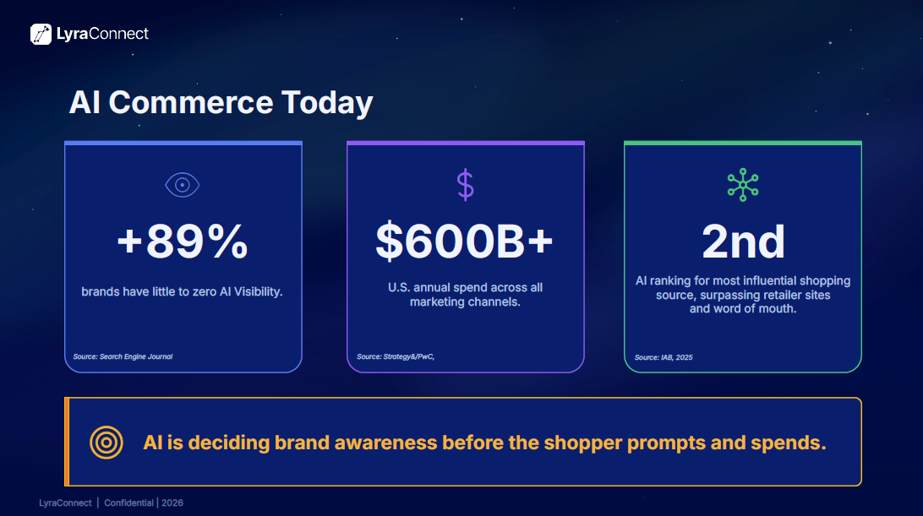

Slide 9
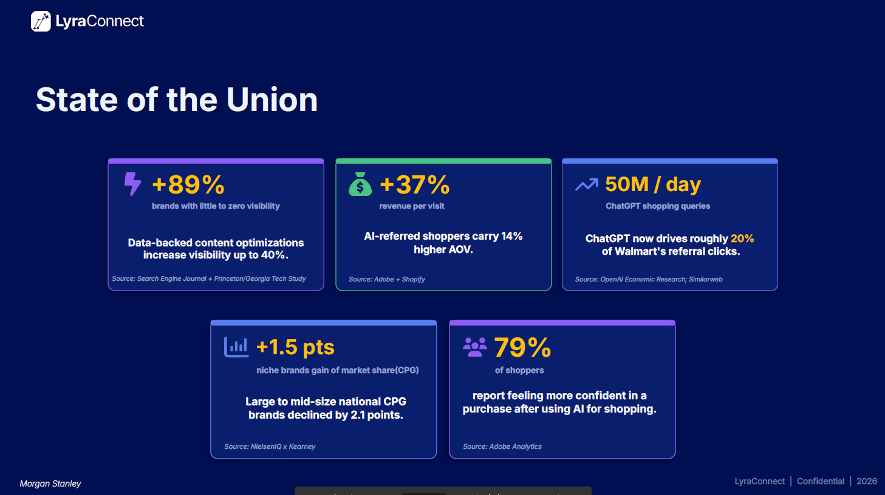

Slide 10
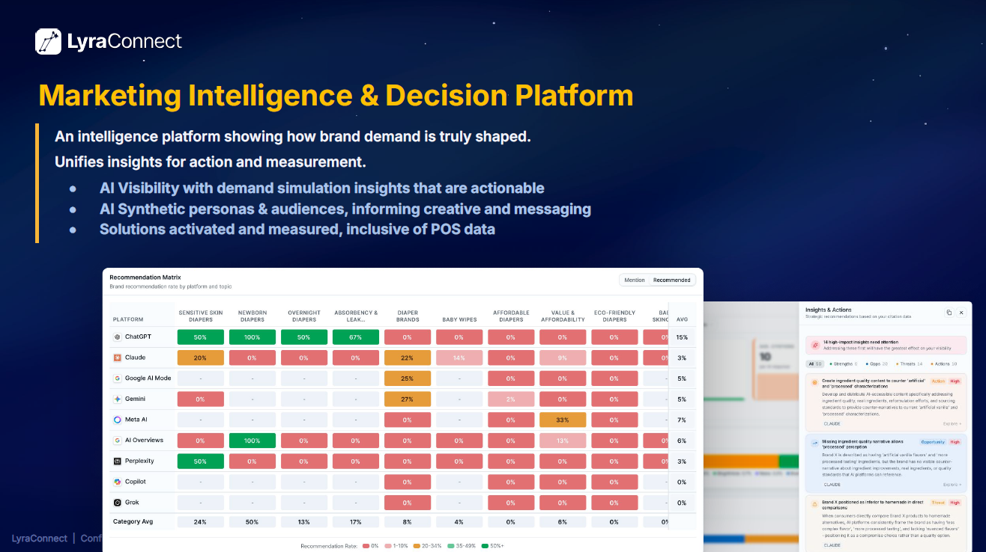

Slide 11
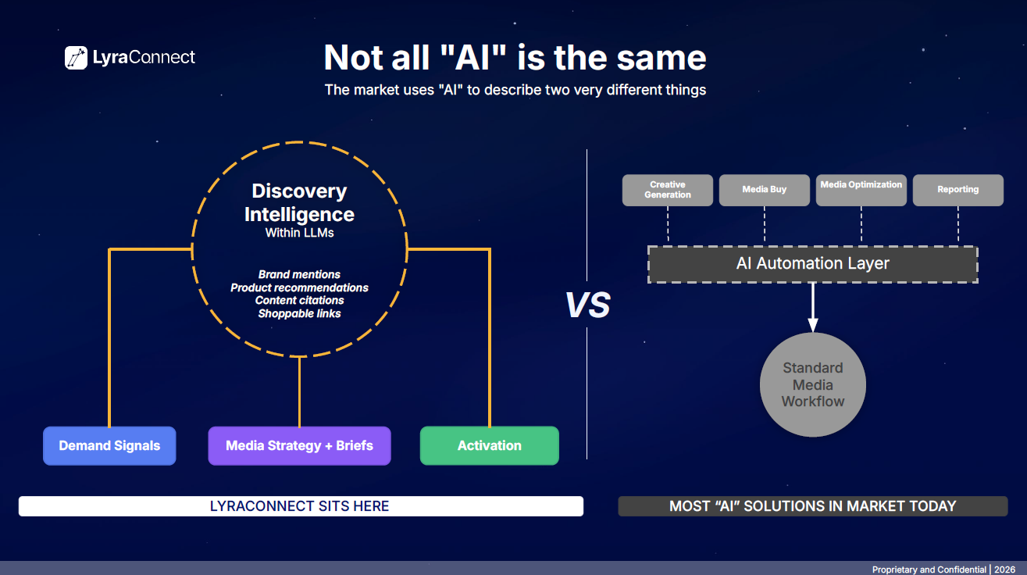

Slide 12
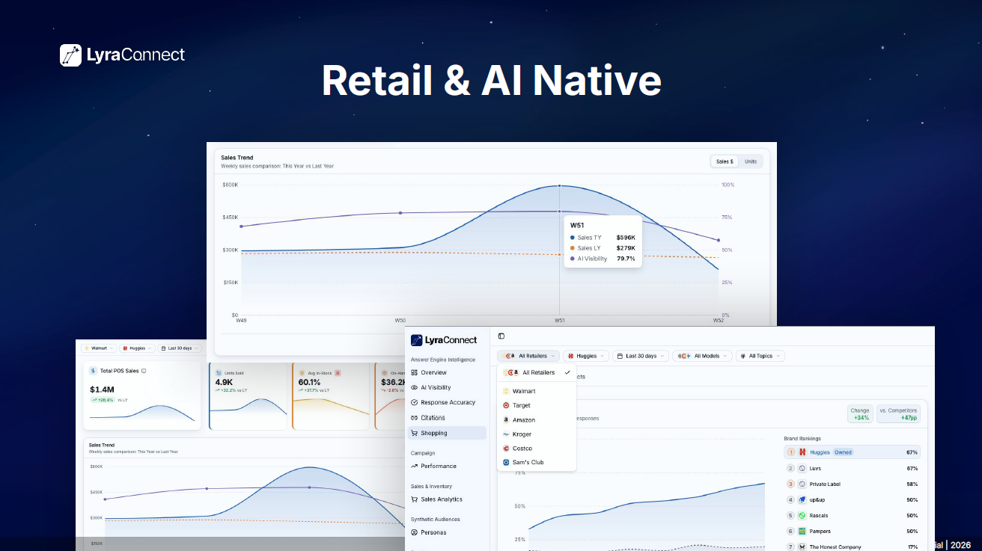

Slide 13
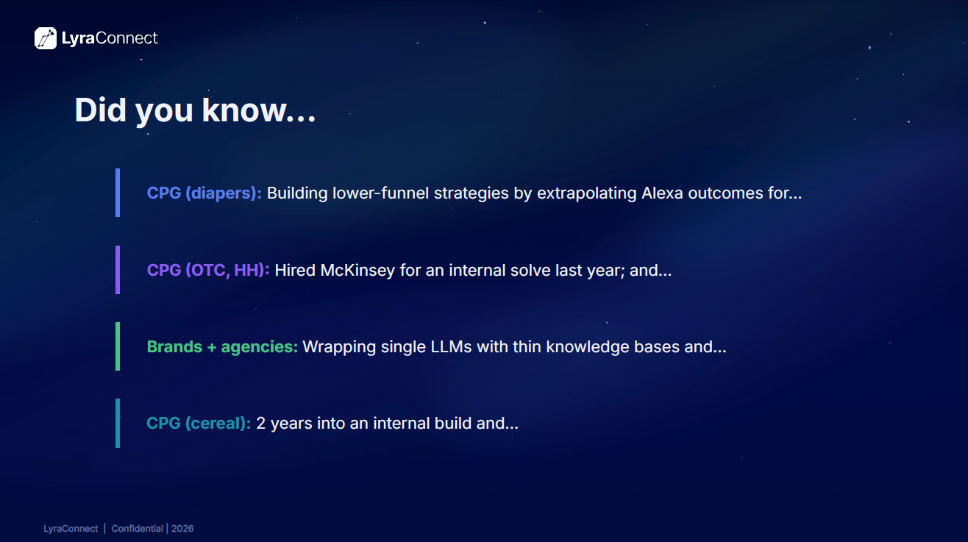

Slide 14
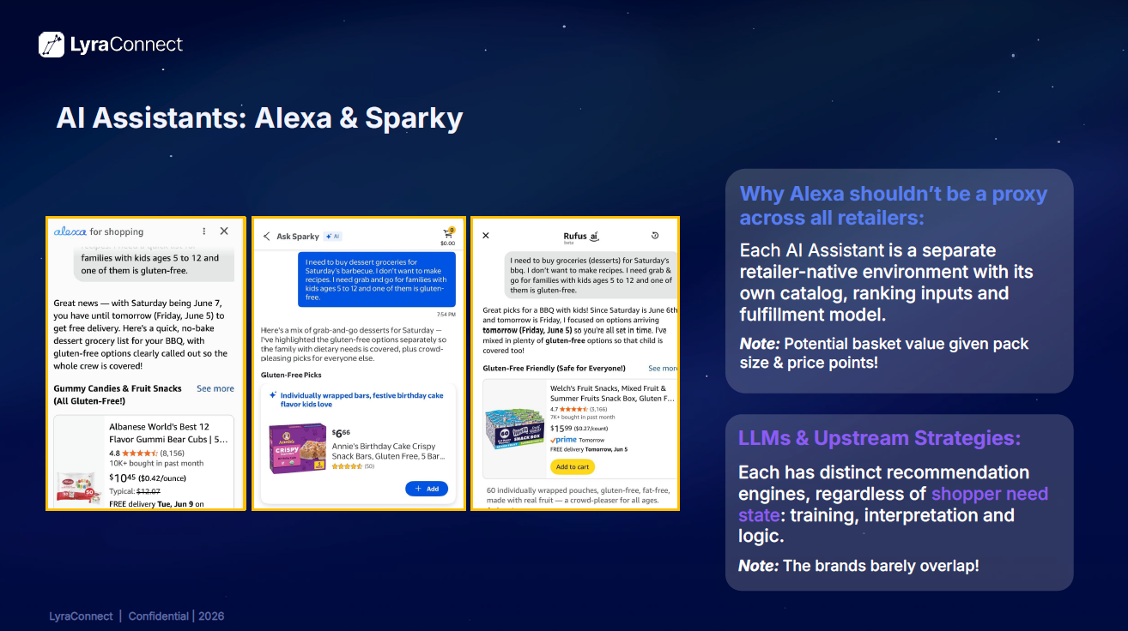

Slide 15
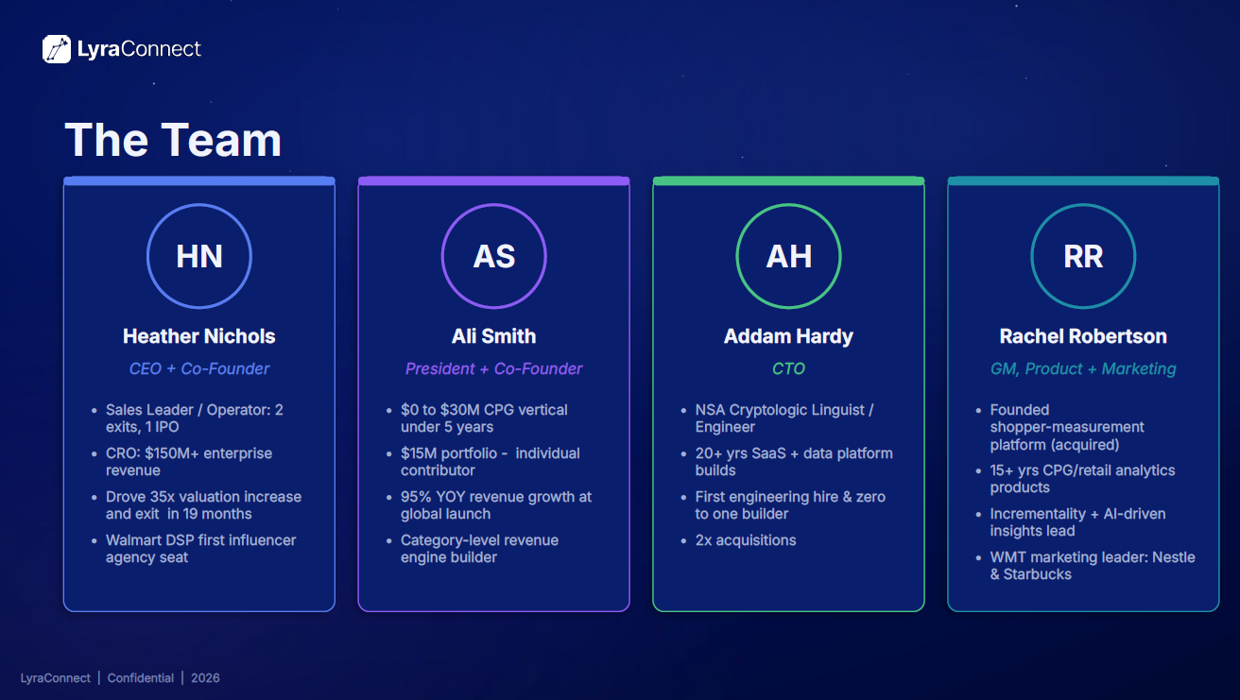

Slide 16
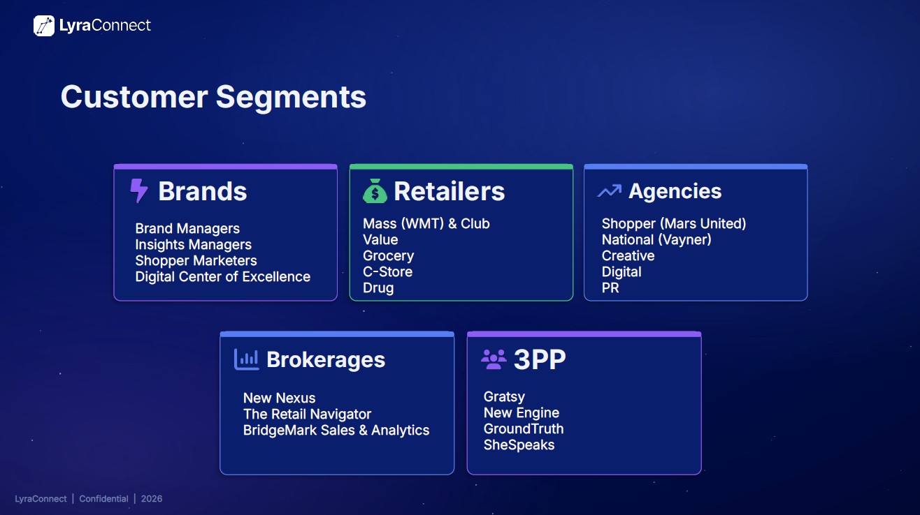

Slide 17
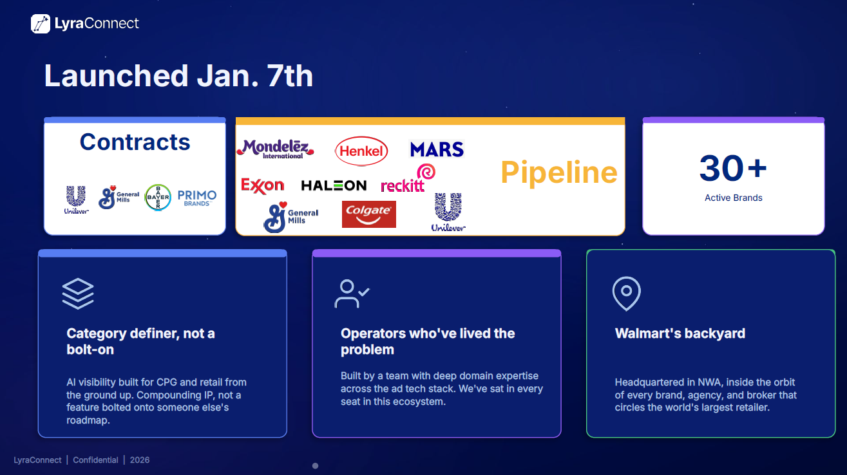

Slide 18
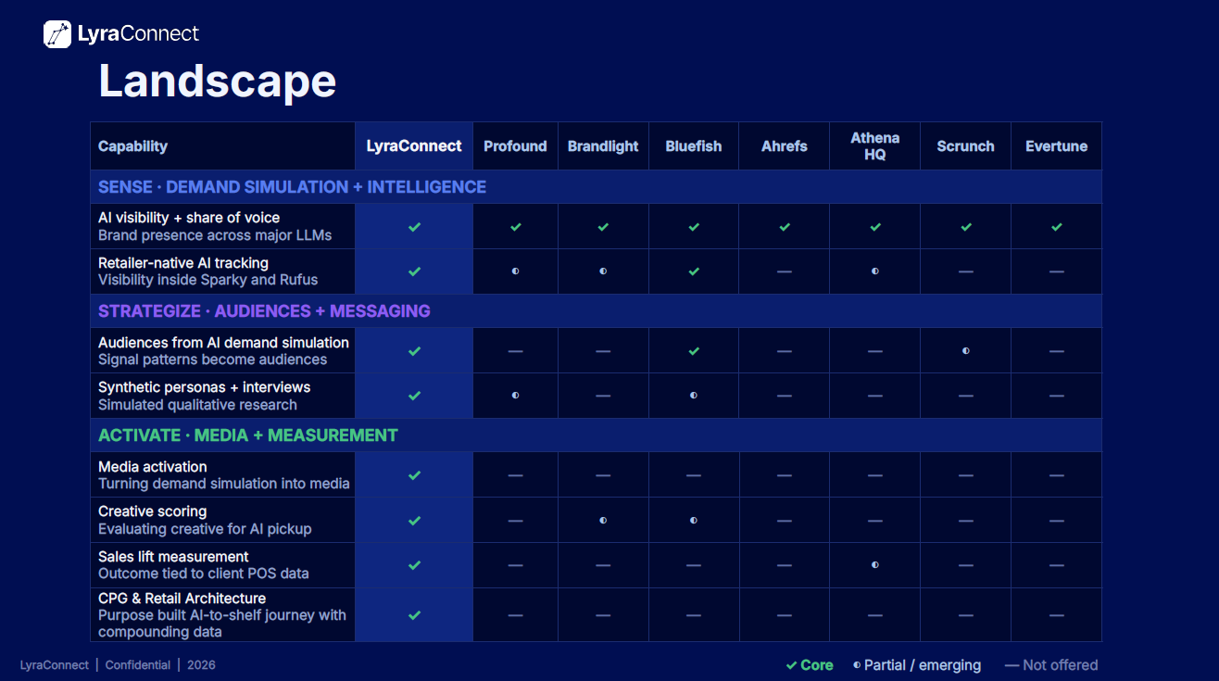

Slide 19


Slide 20
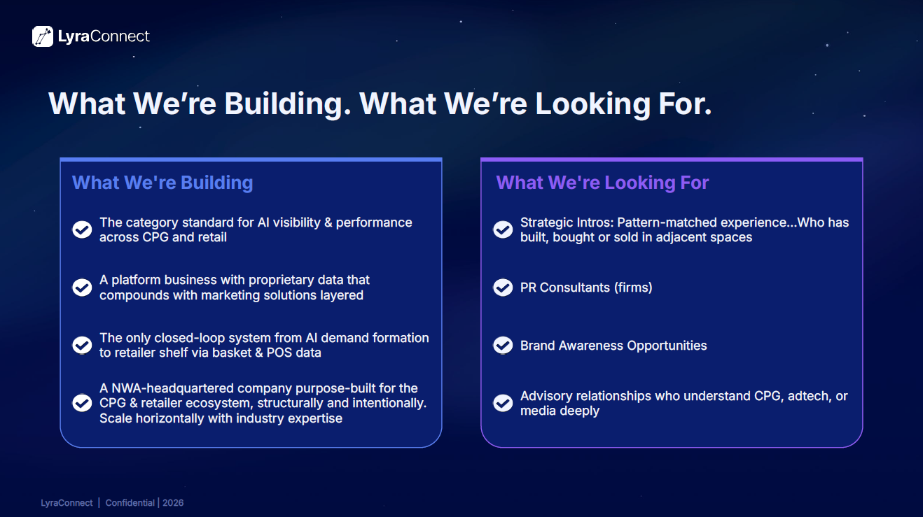

Slide 21


Slide 22

July 2026
Community
ANNOUNCEMENTS

Slide 23


Slide 24

https://sam.gov/workspace/contract/opp/4998d1c8f414490fb5590752d607f21b/view

Slide 25


Upcoming Workshops
Link: https://AFICMCO-Kiva-English.eventbrite.com
Link: https://BeyondThePitch-AFICMCO.eventbrite.com
Link: https://AFIMCO-KivaEspanol.eventbrite.com
  Emotional Resilience for Food Entrepreneurs, August 27, 1-2:30 pm
  E-Commerce for Food Products: Websites, Online Sales & Digital Marketplaces, October 15, 1:30-3 pm
  Food Safety for Retail Operations ~ ServSafe Certification, November 5, 8:30 am - 5 pm

Slide 26

Upcoming Workshops
Link: https://AFICMCO-Kiva-English.eventbrite.com
Link: https://BeyondThePitch-AFICMCO.eventbrite.com
  Emotional Resilience for Food Entrepreneurs, August 27, 1-2:30 pm
  E-Commerce for Food Products: Websites, Online Sales & Digital Marketplaces, October 15, 1:30-3 pm
  Food Safety for Retail Operations ~ ServSafe Certification, November 5, 8:30 am - 5 pm

Slide 27

Upcoming Workshops
Link: https://AFICMCO-Kiva-English.eventbrite.com
Link: https://BeyondThePitch-AFICMCO.eventbrite.com
Link: https://AFIMCO-KivaEspanol.eventbrite.com
  Emotional Resilience for Food Entrepreneurs, August 27, 1-2:30 pm
  E-Commerce for Food Products: Websites, Online Sales & Digital Marketplaces, October 15, 1:30-3 pm
  Food Safety for Retail Operations ~ ServSafe Certification, November 5, 8:30 am - 5 pm

Slide 28
Thank you for joining us!
See you next month!
Next meeting will be held August 5th at 10 CT

