Slide 1

Welcome to the ESO Call!
10am -11am CT
First Wednesday of Each Month

Slide 2
June ESO Call Agenda
I. Welcome
II. New Member Introductions
Please introduce yourself and let us know how we can connect with you.
III. Entrepreneurial Spotlight
IV. Community Announcements

Slide 3

Considerations
We begin promptly at
10am CT on the ﬁrst Wednesday of each month. Calls are limited to one hour.
Meetings are recorded and will be made available upon request.
Please mute your microphones unless speaking.
If you have an announcement, please make sure you send it in our announcement link on our website.

Slide 4
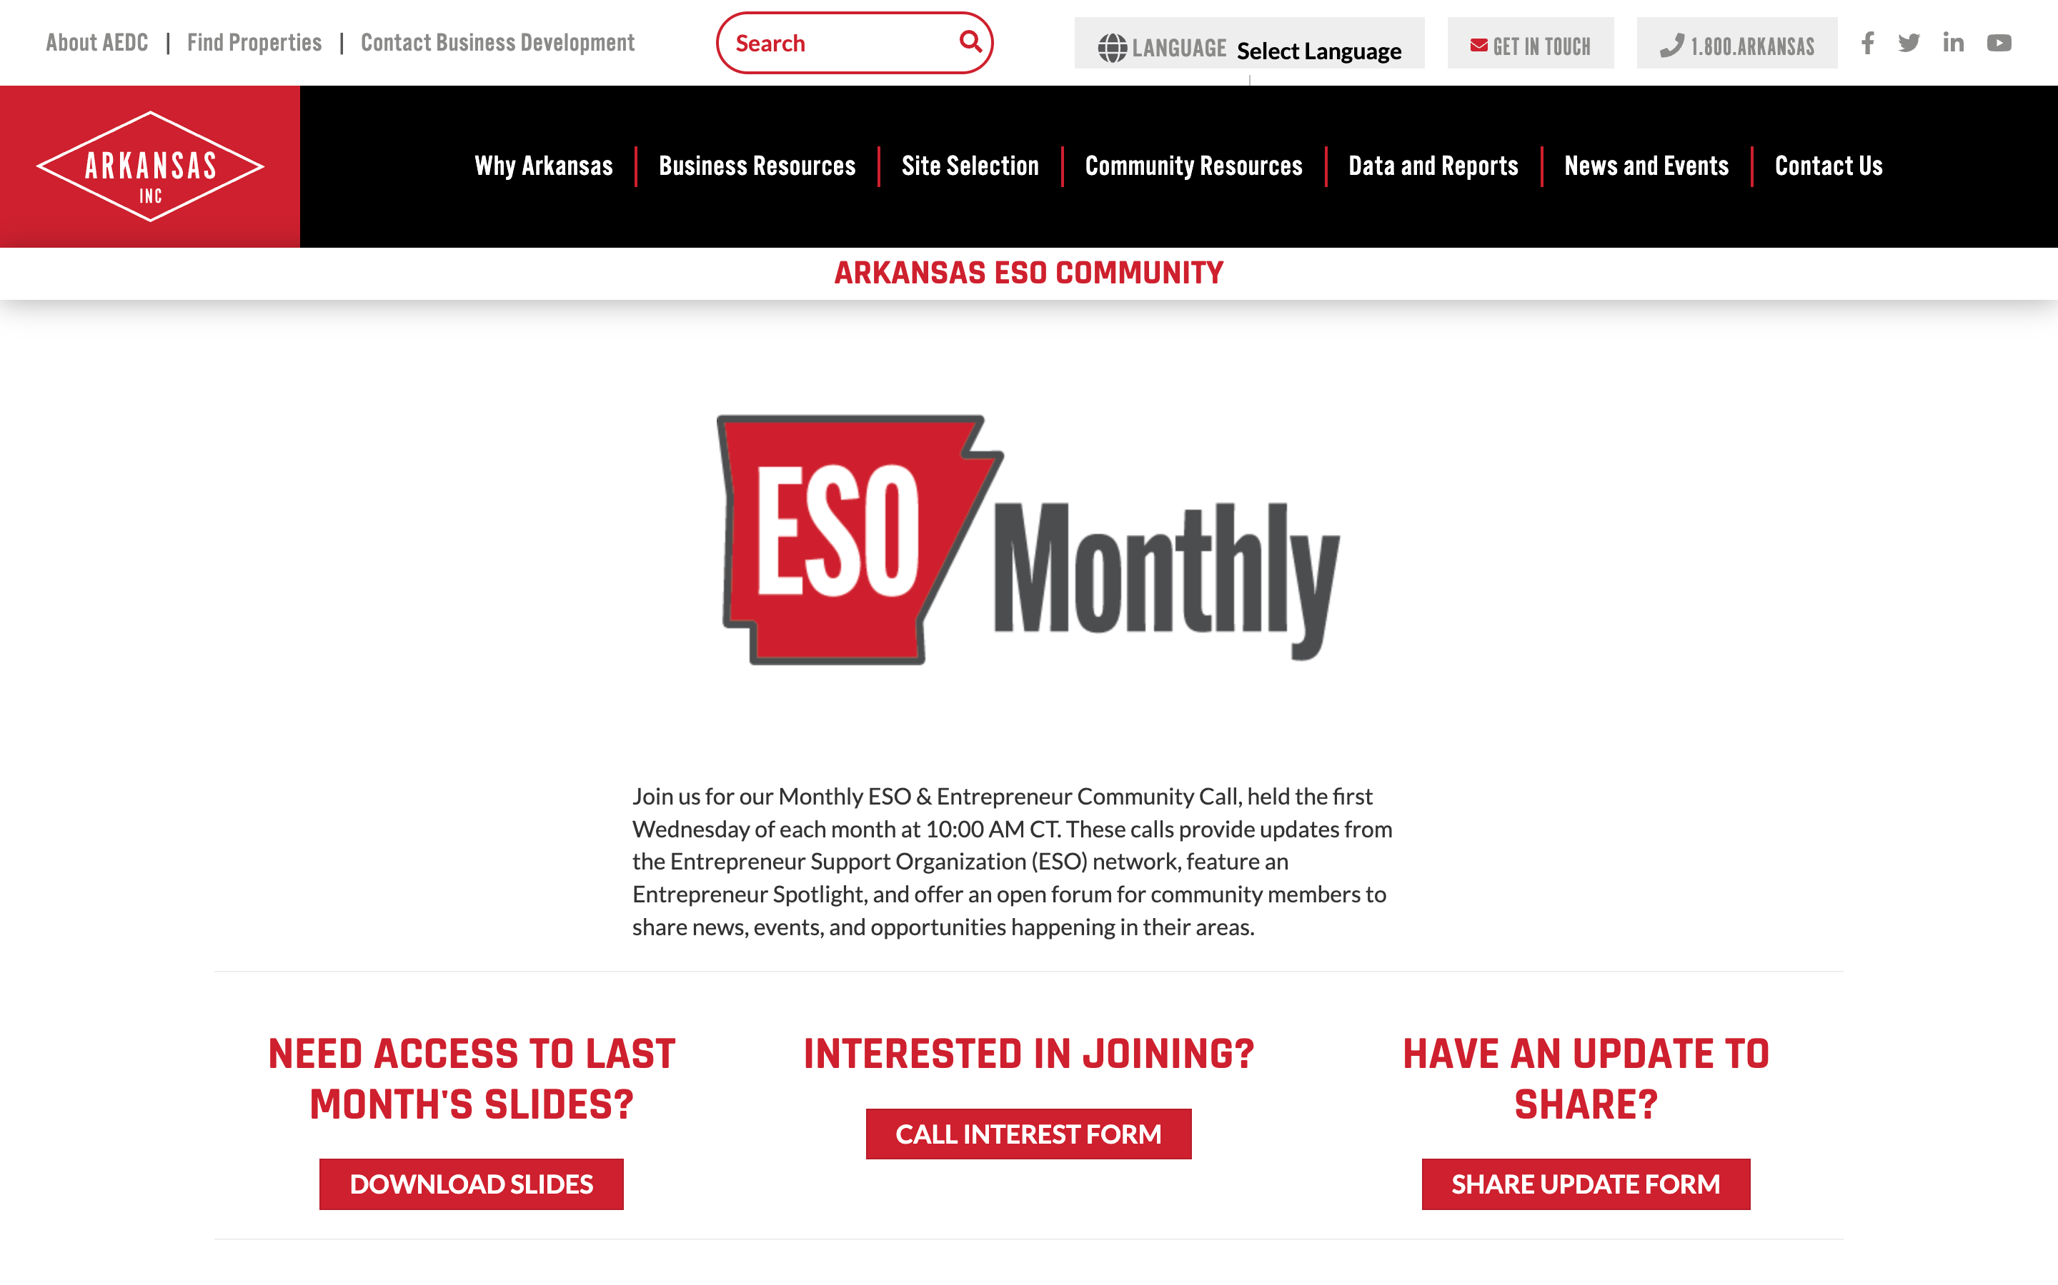
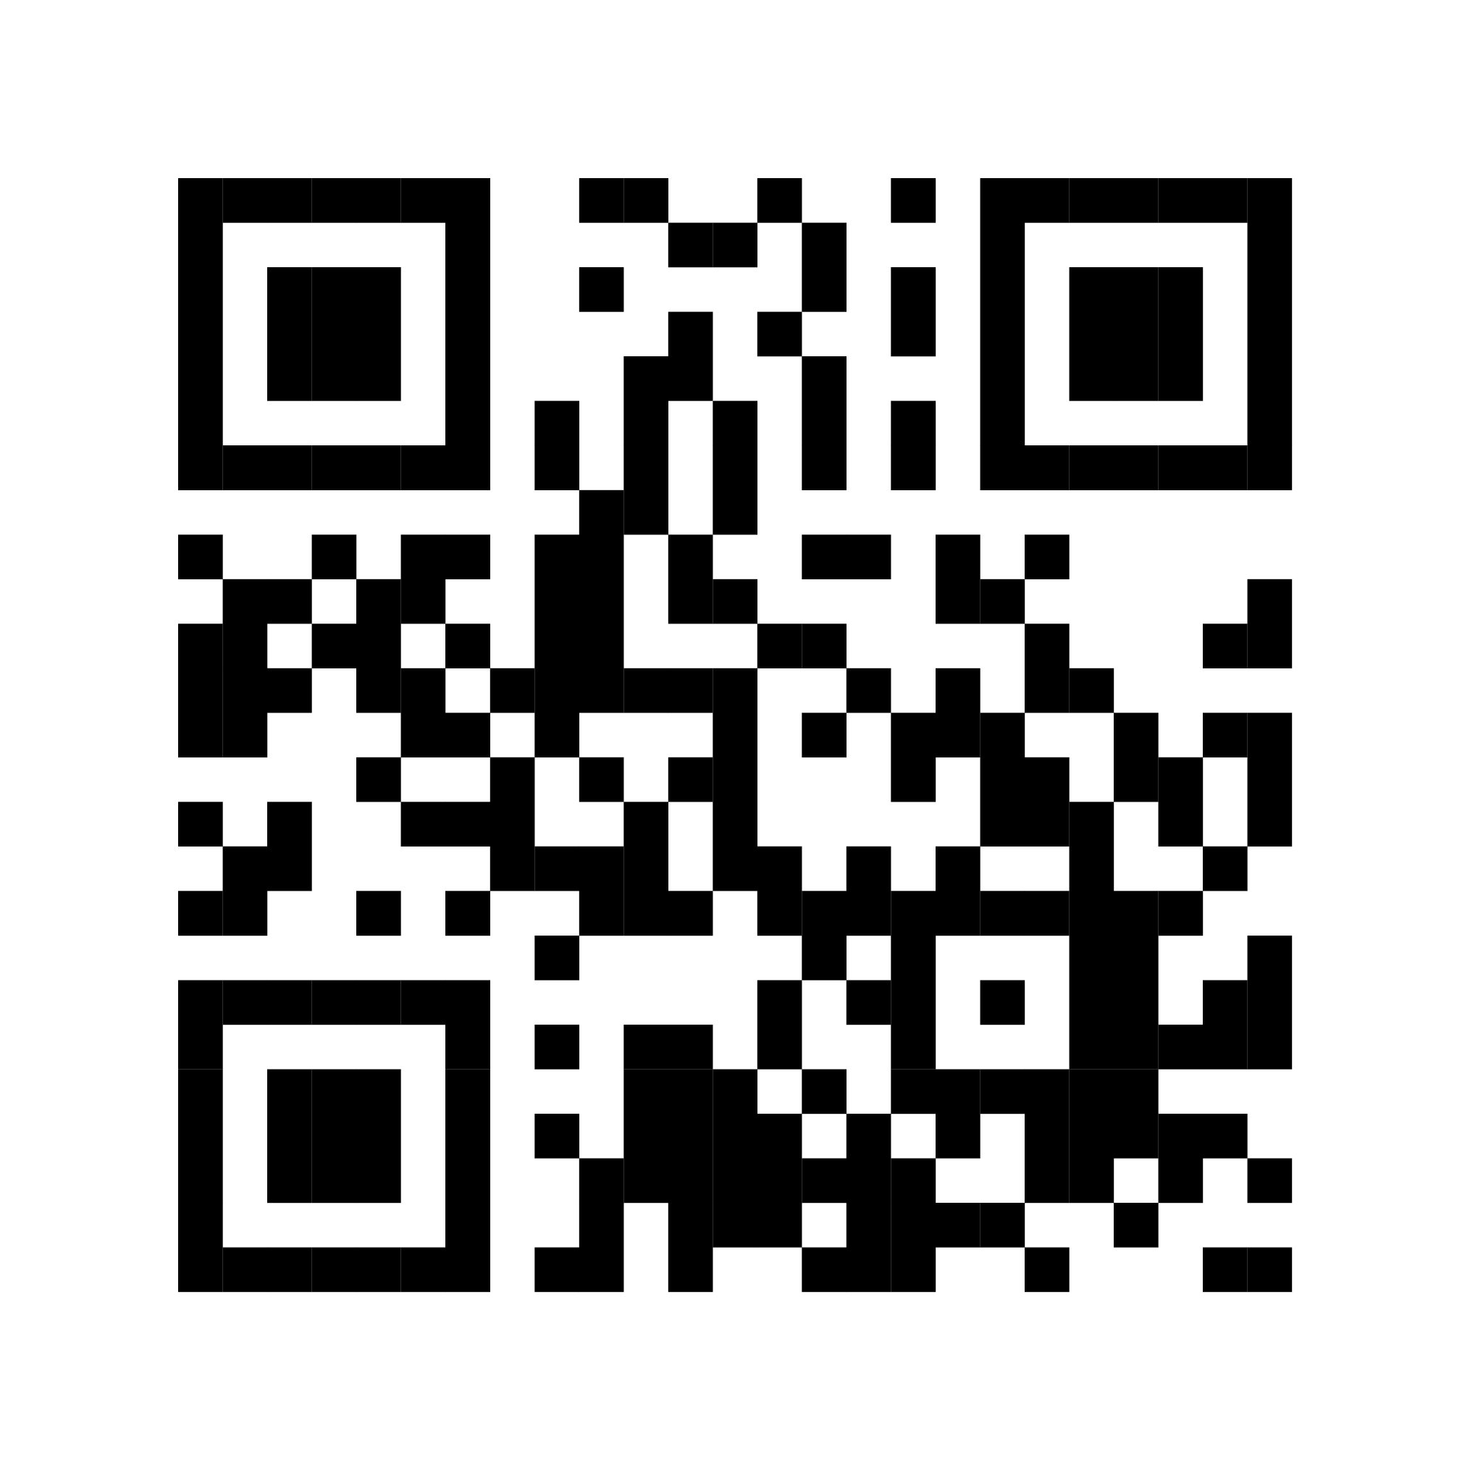
ESO Call Landing Page
A central location where you can find important links such as the call’s joining link, community updates, the previous ESO slide deck, and more.
If you have questions or concerns, please contact:
Esperanza Massana Crane, SBED Director
Arkansas Economic Development Commission
EMassana@Arkansasedc.com
bit.ly/AR-ESO

Slide 5
New Member Introductions

Slide 6
Entrepreneurial Highlight – Evergreen Designs

Slide 7

June 2026
Community
ANNOUNCEMENTS

Slide 8
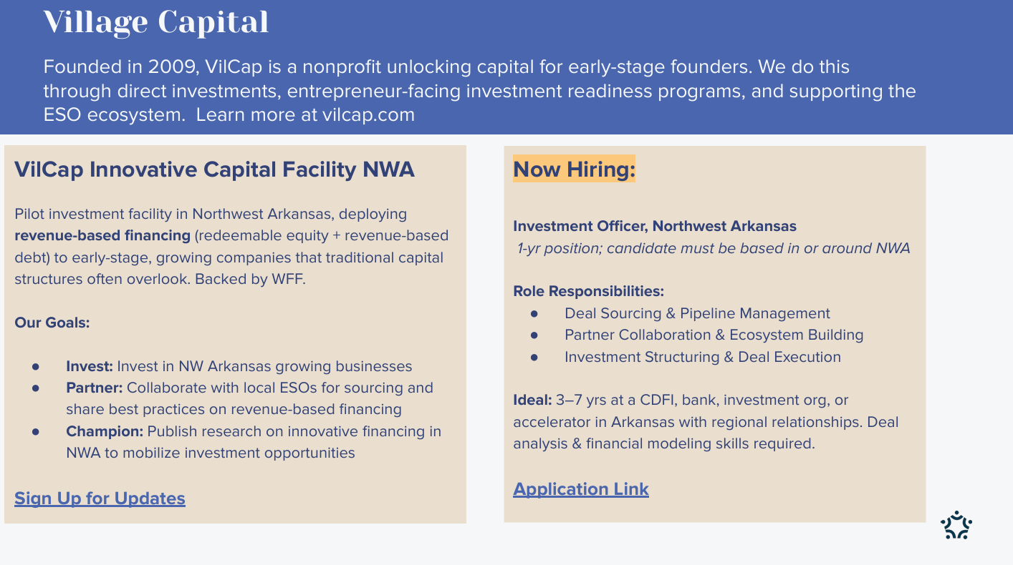

Slide 9


Upcoming Workshops
Link: https://Packaging-Rest-Caterers-FoodTrucks.eventbrite.com
Link: https://BeyondThePitch-AFICMCO.eventbrite.com
  Emotional Resilience for Food Entrepreneurs, August 27, 1-2:30 pm
  E-Commerce for Food Products: Websites, Online Sales & Digital Marketplaces, October 15, 1:30-3 pm
  Food Safety for Retail Operations ~ ServSafe Certification, November 5, 8:30 am - 5 pm

Slide 10


Link to Apply:
Shared-use-Kitchen-Manager_R0084813-1
Share!

Slide 11

entrepreneurs & small business owners
wanted
Building Business & Civic Connections:
Entrepreneurs in Conversation with Elected Officials & City Representatives
Monday, June 22 | 4 - 5:30 PM
An interactive Entrepreneur Roundtable + Civic Conversation session is specifically designed for entrepreneurs and small business owners who want to actively participate in shaping stronger local business conditions across Northwest Arkansas.
Participating leaders include representatives from Bentonville, Rogers, Springdale, Fayetteville, and Pea Ridge.
This is:
•An opportunity for entrepreneurs to engage directly with local leaders to move business bottlenecks toward actionable next steps
We are asking ESOs and ecosystem partners to:
• Encourage entrepreneurs in your network to register
• Invite founders and business owners ready to actively participate
• Help bring entrepreneurs willing to share both challenges and ideas
• Support a collaborative “let’s work together” mindset
Location: The Collaborative, The Learning Lab, 704 SE 5th St, Bentonville
To Register: https;//righttostart.quorum.us/event/34247/

Slide 12
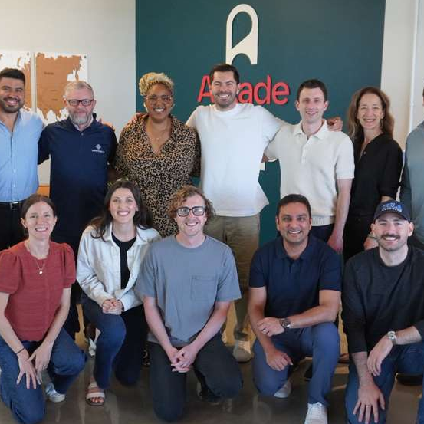
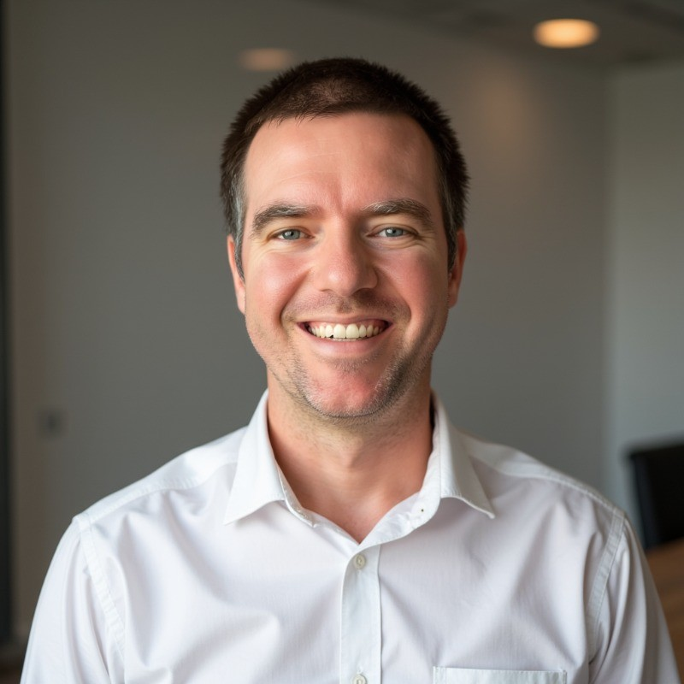
Endeavor Updates
ScaleUp Spring Cohort Wraps Up on June 18th!
Welcome Chris Erhardt, the new 412 Angels Director!

Slide 13



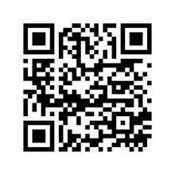
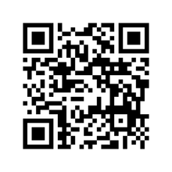

DEMO NIGHT
Meet the 2026 Arkansas Global Cycling Accelerator Cohort
JUNE 10, 2026 / 5:00 - 7:00 PM
Compton Gardens / 312 N. Main St, Bentonville, AR
SCAN TO LEARN MORE ABOUT THE COHORT
arkansascyclingaccelerator.com
QR
CODE
Innovation In It’s Natural State

Slide 14

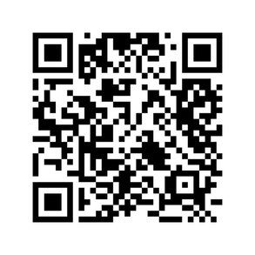


DEMO NIGHT & PRODUCT MARKET
CELEBRATING THE INAUGURAL COHORT OF THE OZARK RETAIL ACCELERATOR
SCAN TO RSVP
JUNE 17, 2026 / 4:30 - 7:00 PM
Funding Provided By
University of Arkansas Collaborative Learning Lab
704 SE 5th St, Bentonville, AR 72712
4:30 PM Happy Hour & Networking
5:00 PM Founder Pitch Presentations
6:30 PM Product Market & Community Networking
ozarkretailaccelerator.com
Presented by UA Office of Entrepreneurship & Innovation + Act II Capital Holdings

Slide 15
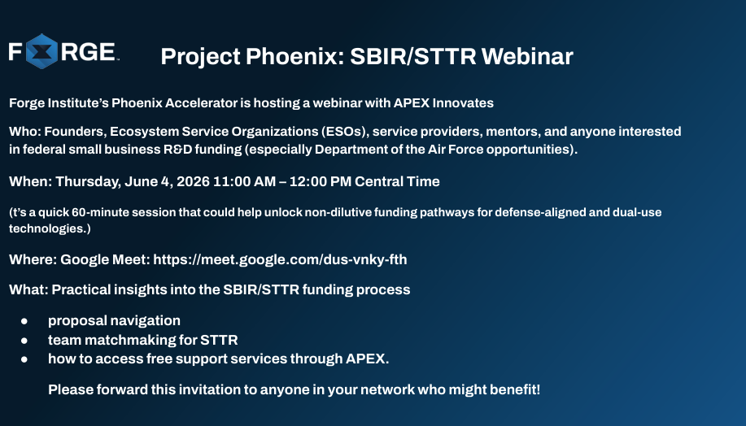

Slide 16
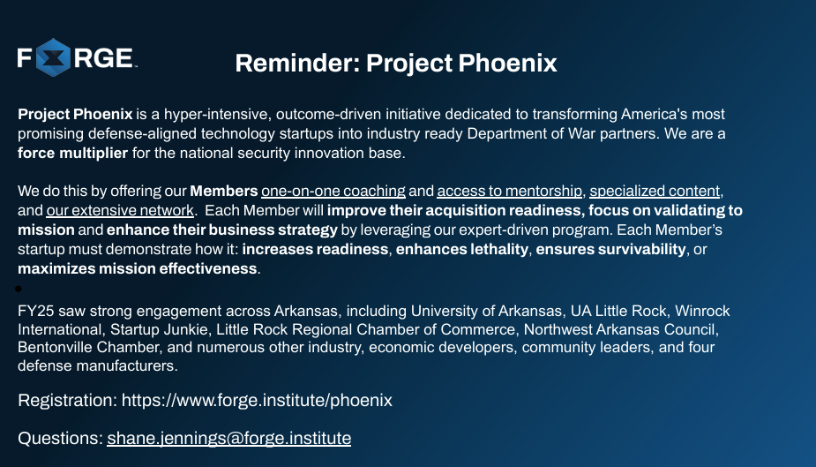

Slide 17
Thank you for joining us!
See you next month!
Next meeting will be held July 1 at 10 CT

