Slide 1

Welcome to the ESO Call!
10am -11am CT
First Wednesday of Each Month

Slide 2
March ESO Call Agenda
I. Welcome
II. New Member Introductions
Please introduce yourself and let us know how we can connect with you.
III. Entrepreneurial Spotlight
CC Young & Craig Featherson, co-founders of Lineup
IV. Community Announcements

Slide 3





Considerations
We begin promptly at
10am CT on the ﬁrst Wednesday of each month. Calls are limited to one hour.
Meetings are recorded and will be made available upon request.
Please mute your microphones unless speaking.
If you have an announcement, please make sure you send it in our announcement link on our website.

Slide 4


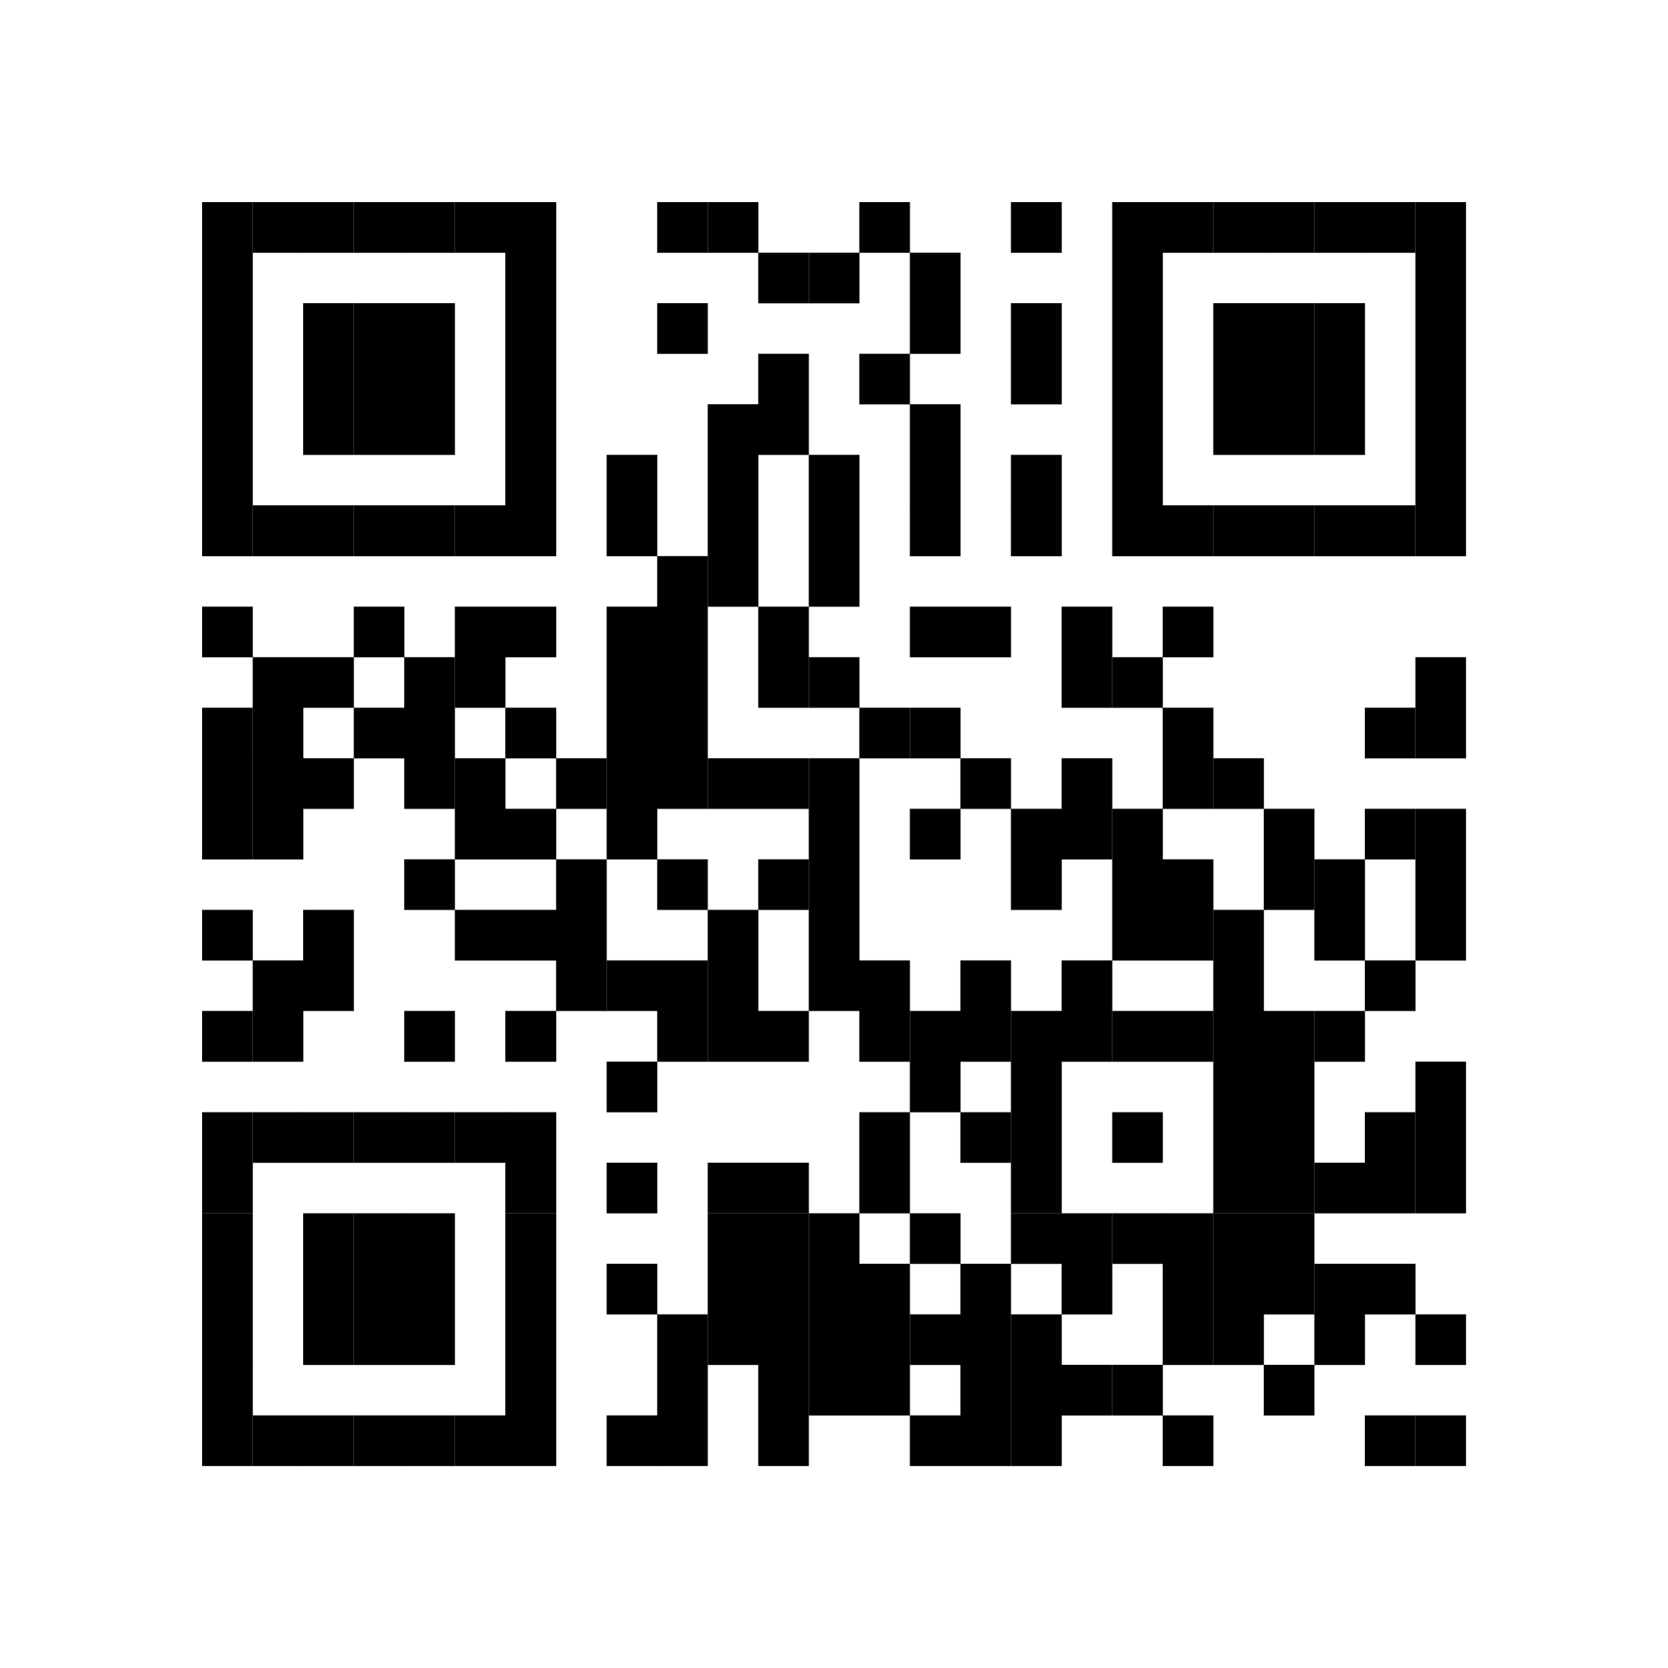
ESO Call Landing Page
A central location where you can find important links such as the call’s joining link, community updates, the previous ESO slide deck, and more.
If you have questions or concerns, please contact:
Mallory Race, Senior Project Manager
Arkansas Economic Development Commission
Mallory.Race@ArkansasEDC.com
bit.ly/AR-ESO

Slide 5
New Member Introductions

Slide 6


Slide 7


Slide 8


Slide 9


Slide 10
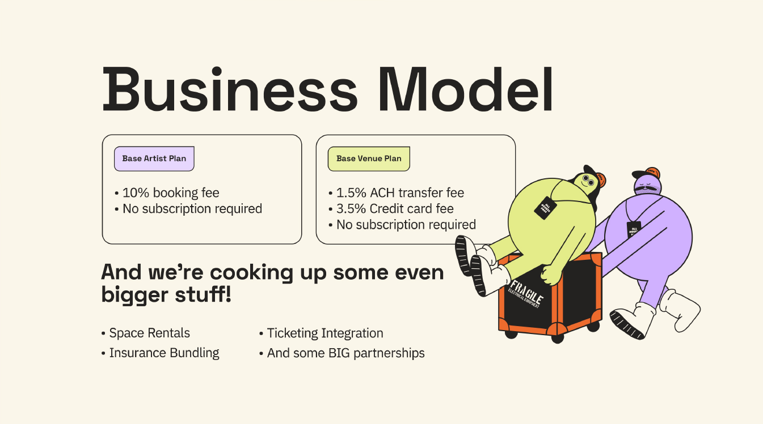

Slide 11
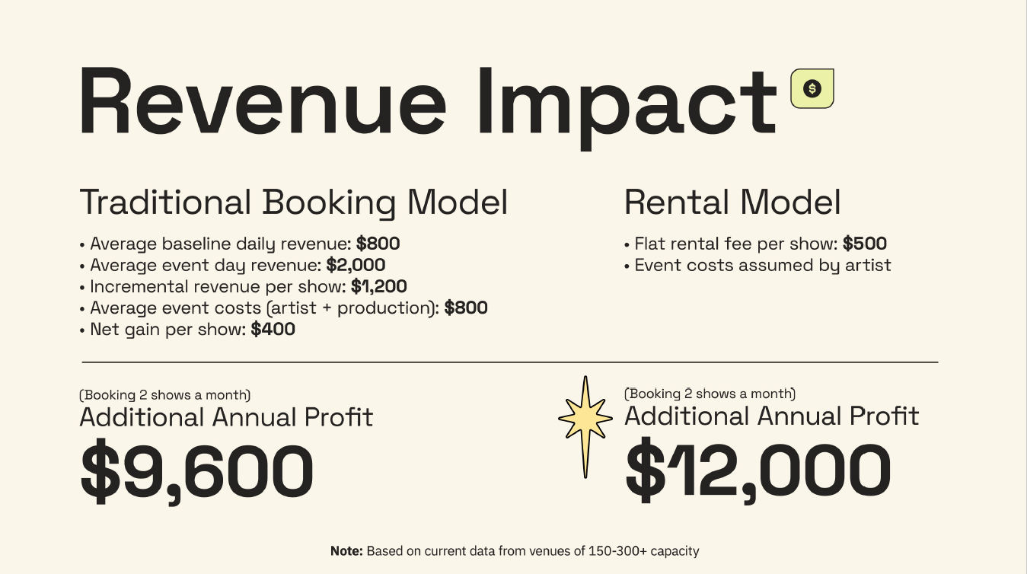

Slide 12
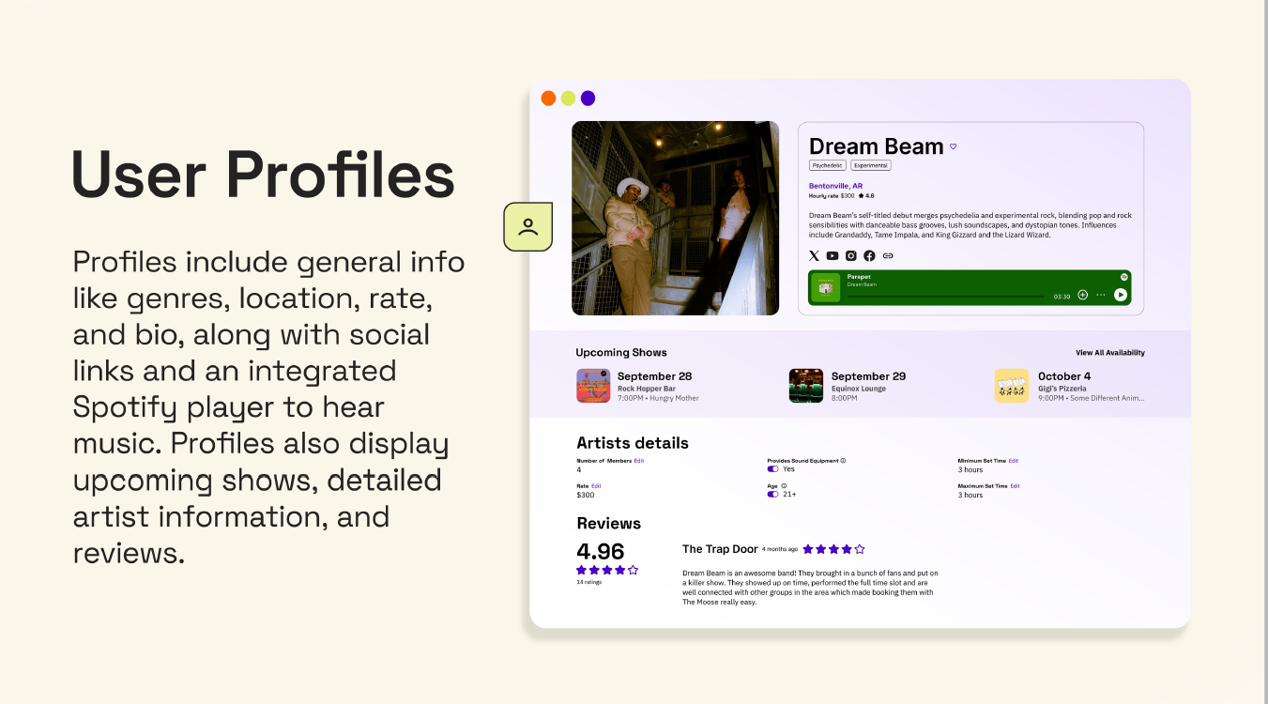

Slide 13


Slide 14


Slide 15


Slide 16


March 2026
Community
ANNOUNCEMENTS

Slide 17


Slide 18


Slide 19


Slide 20


Slide 21


Slide 22
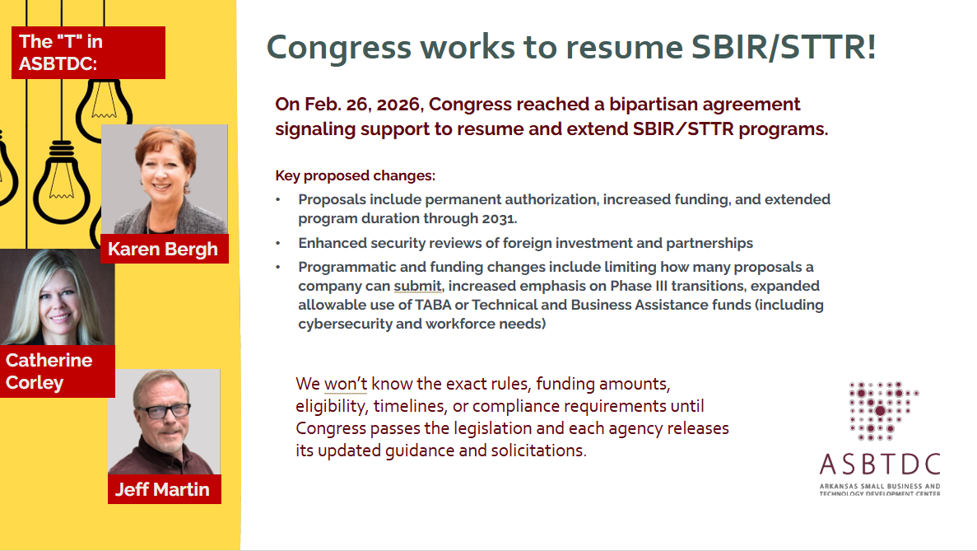

Slide 23



Slide 24


Slide 25


Slide 26


Slide 27

Please complete our Entrepreneur Support Organization Survey

Slide 28
Thank you for joining us!
See you next month!
Next meeting will be held April 1st at 10 CT

